Slide 1



CARDIOVASCULAR PATIENTS HOSPITAL ADMISSION USING STATISTICAL & ML TECHNIQUES
Team
Carlos Magno Nascimento
Ekpo Archibong Md Athar Khan Md. Sajid Shaila Hossain

Slide 2
Agenda
Dataset description
Description of Some Variables
Research questions
Data wrangling
Analysis
Conclusion
References

Slide 3
Dataset Description
Cardiovascular disease is one of the leading causes of death globally.
Available in the Kaggle portal.
Collected from patients admitted from 2017 to 2019 at Hero DMC Heart Institute, India.
DATASET | ATTRIBUTES | DESCRIPTION | VARIABLE TYPE
HDHI Admission data | Rows:15757, Columns:56 File Type: CSV | Dataset were related to patients date of admission and discharge demographics type of admission and outcome patient history such as smoking, alcohol, hypertension. lab parameters such as hemoglobin, platelets, glucose, urea, creatinine. Other 28 features including heart failure, acute kidney disease. | Categorical: 40 Numerical: 16
DATASET | ATTRIBUTES | DESCRIPTION
Table Headings | Rows: 57, Columns:2 File Type: CSV | This data table has the descriptive headlines for all columns for the HDHI Admission data file.

Slide 4
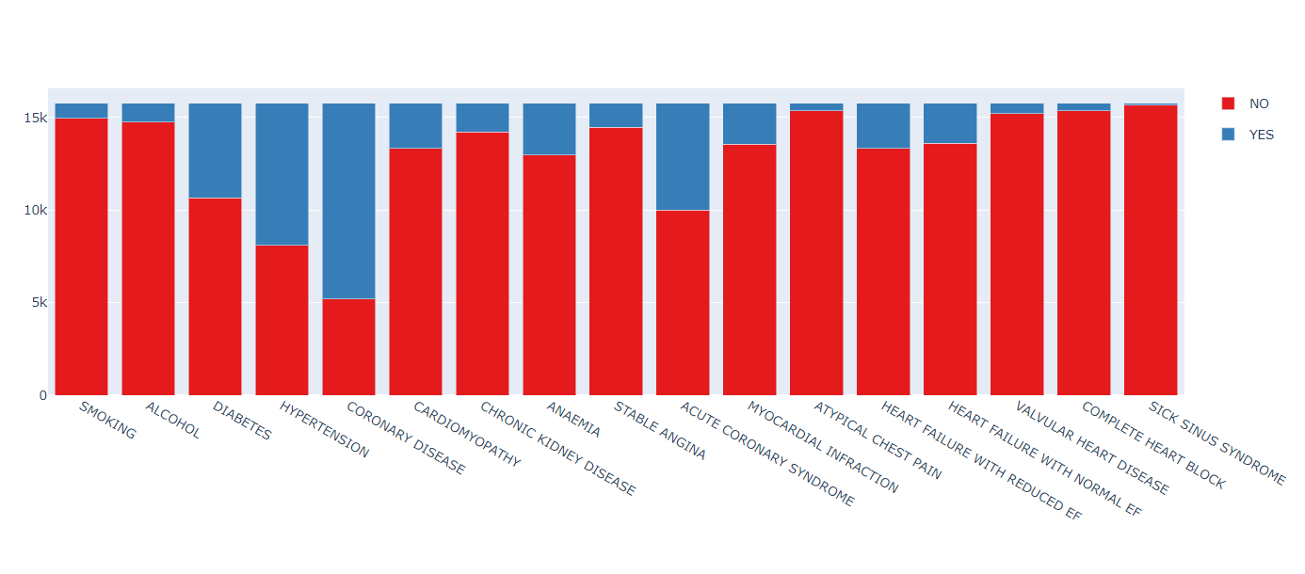
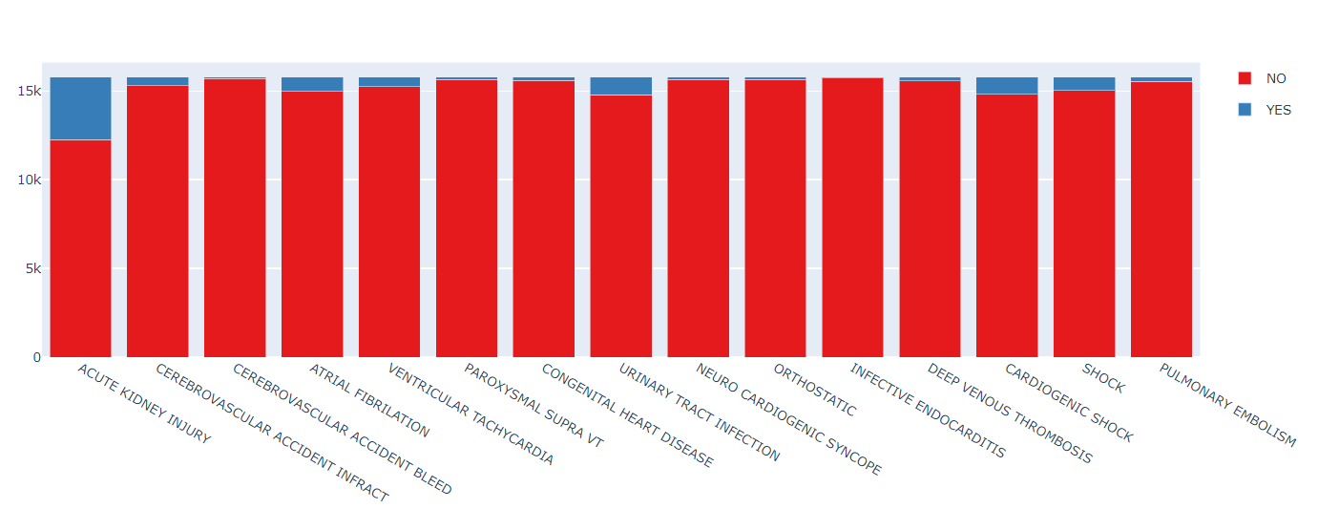
Description of Some Variables
QUANTITATIVES:
QUALITATIVES:
DURATION.OF.STAY (days) HEART.FAILURE (Y,N)
AGE (years) AKI = ACUTE KIDNEY INJURY (Y,N)
GLUCOSE (mg/dL) GENDER (M,F)
HB = Haemoglobin (g/dL) CAD = Coronary Artery Disease (Y,N)
EF = Ejection Fraction (%) OUTCOME (EXPIRY, DISCHARGE, DAMA = Discharge against medical advice)
UREA (mg/dL) DM = Diabetes Mellitus (Y,N)

Slide 5
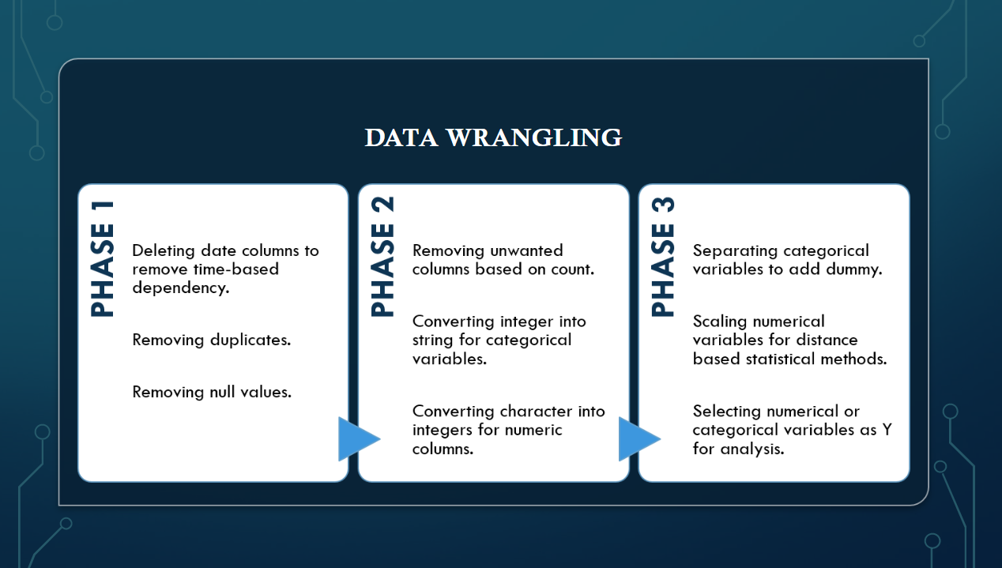
RESEARCH QUESTIONS
Which independent variables are the most important to predict heart failure, AKI, Outcome and Duration of Stay?
Which statistical/ML method best predicts heart failure, AKI and Outcome in terms of accuracy rate?
Which statistical/ML method best predicts Duration of Stay in terms of mean squared error?

Slide 6

STATISTICAL & ML METHODS UTILIZED
Feature Scaling
KNN & SVM
Random Forest
Logistic Regression
LDA & QDA
Bagging
Regression Tree
Classification Tree
Gaussian Naïve Bayes
Cross Validation
Gradient Boosting
PCA

Slide 7


ANALYSIS ( Heart failure AKI, OUTCOME & DURATION OF STAY)

Slide 8
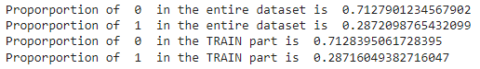
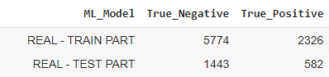
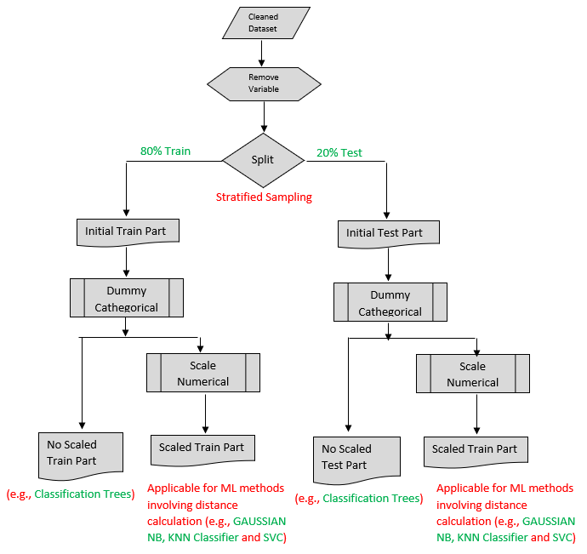
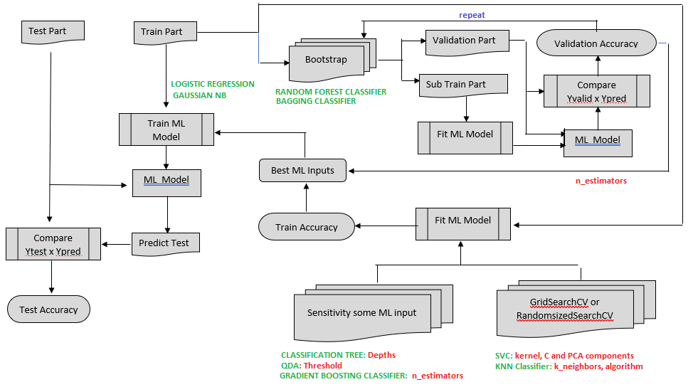
HEART FAILURE - METHODOLOGY
1 – Drop Variables on which HEART.FAILURE is not dependent (e.g., DUARATION.OF.STAY, OUTCOME)
2 – Split the Dataset in Train and Test Parts (80%/20%) with Proportional Allocation (Stratified Sampling)
3 – Qualitative Explanatory Variables as dummies
4 – Duplicate the train and test data frames and Scale the Quantitative Explanatory Variables
5 – ML Models: Procedure
5.1 - Fitted a Logistic Regression Model based on Train Part
5.2 - QDA Model (Fitted the model with default threshold) and done a Sensitivity in Threshold
5.3 - CLASSIFICATION TREE: Sensitivity in Tree Depth and Fitted the model for the best Depth
5.4 - Fitted a GAUSSIAN NB Model based on Train Part
5.5 - Used GridSearchCV to find the best parameters (kernel, C and PCA components) for SVC and Fitted SVC models with them
5.6 - Used GridSearchCV and RandomizedSearchCV to find the best input parameters (k_neighbors and Algoriyhm) for KNN CLASSIFIER and Fitted KNN models with them
5.7 - It was done a sensitivity in n_estimators of RANDOM FOREST and BAGGING in Train Part using BOOTSTRAP to determine the optimum n_estimators for each.

Slide 9
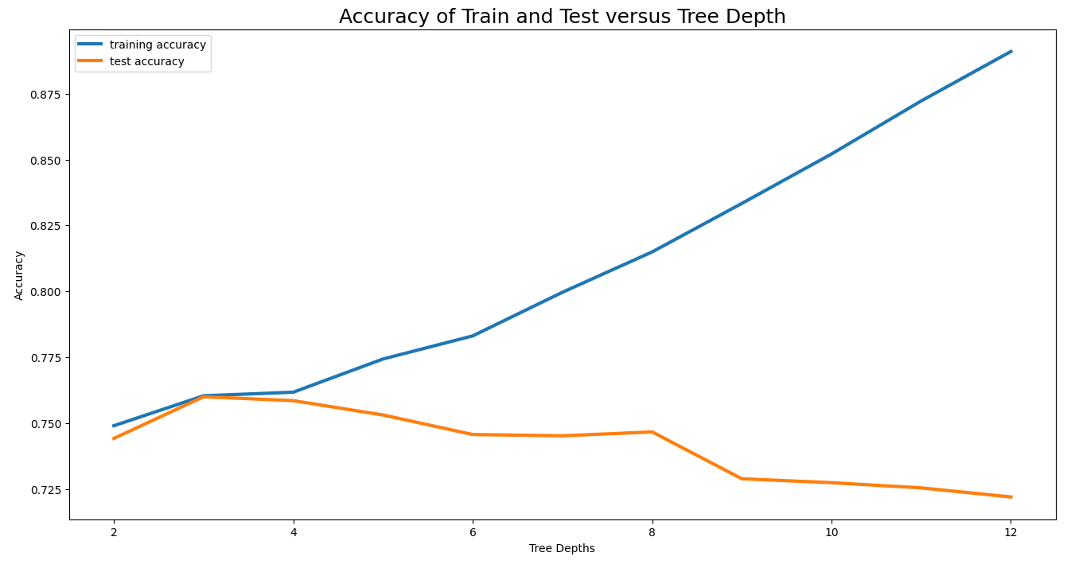
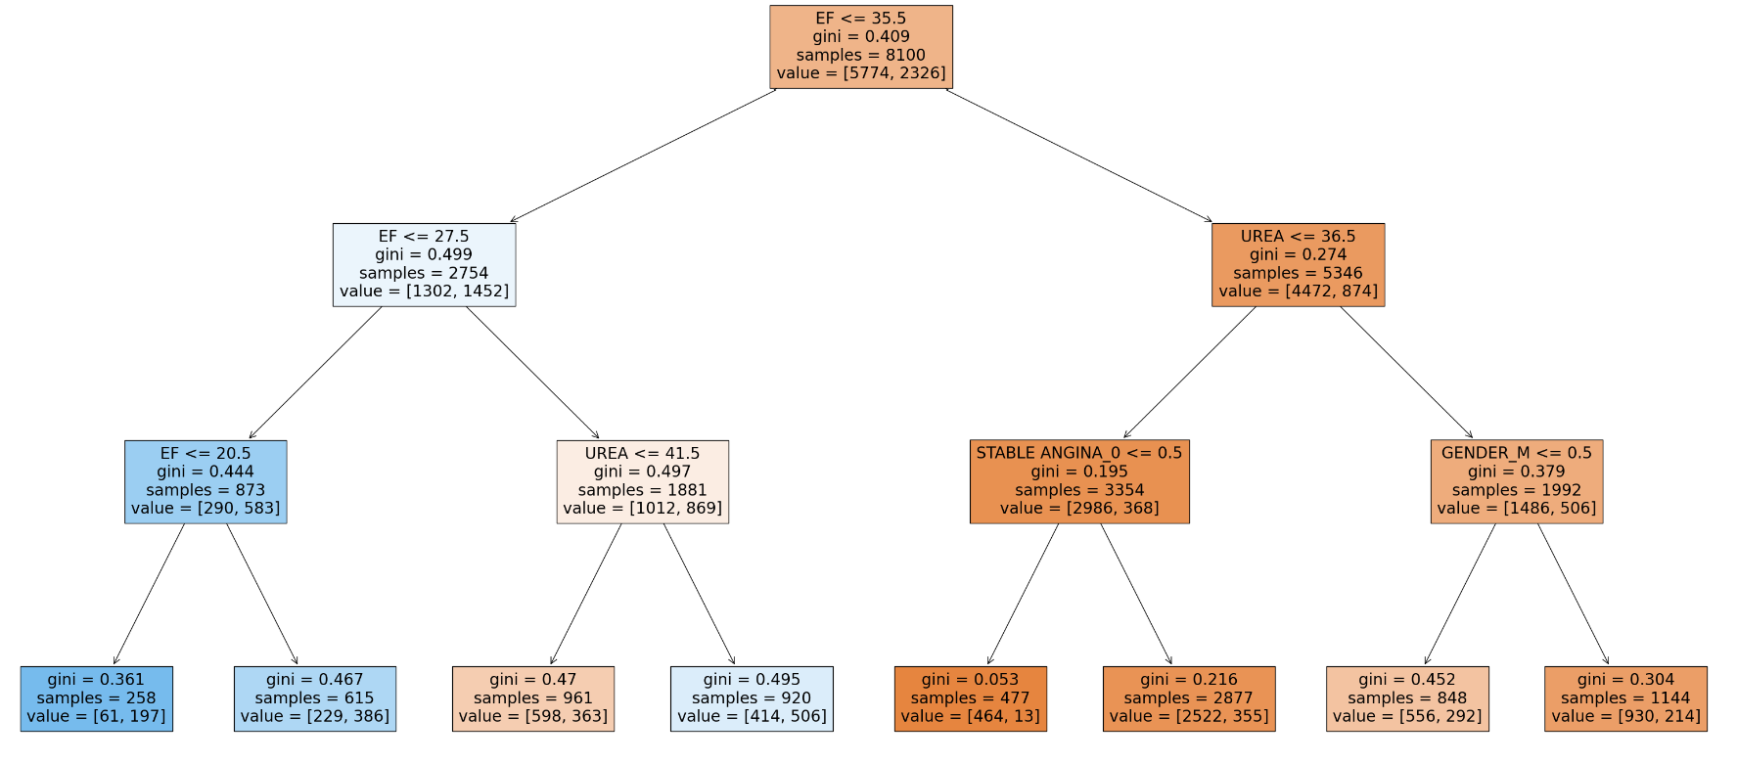
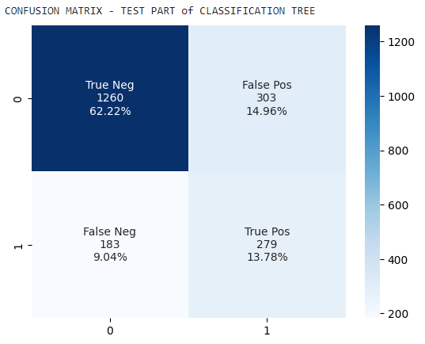
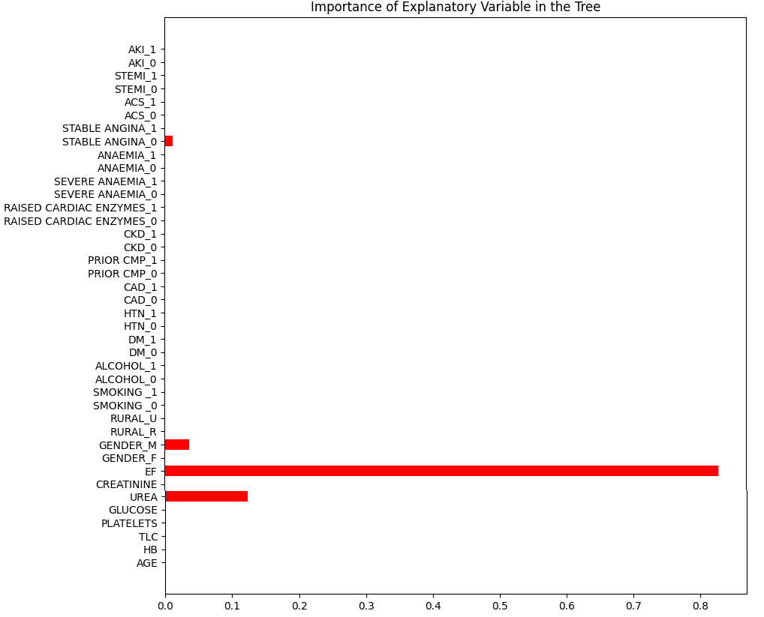
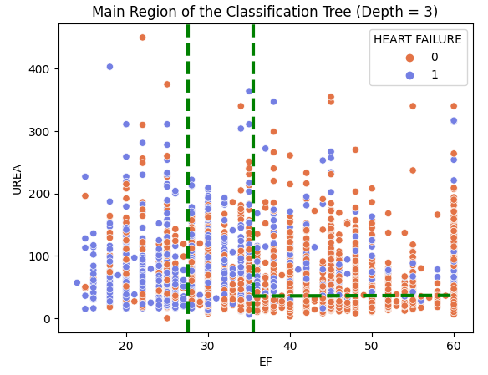
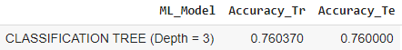
HEART FAILURE – CLASSIFICATION TREE
R1 R2 R3 R4
Max. Test accuracy
3
R1
R2
R4
R3
EF and UREA, the most relevant variables for HEART FAILURE

Slide 10
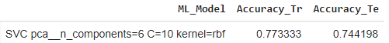
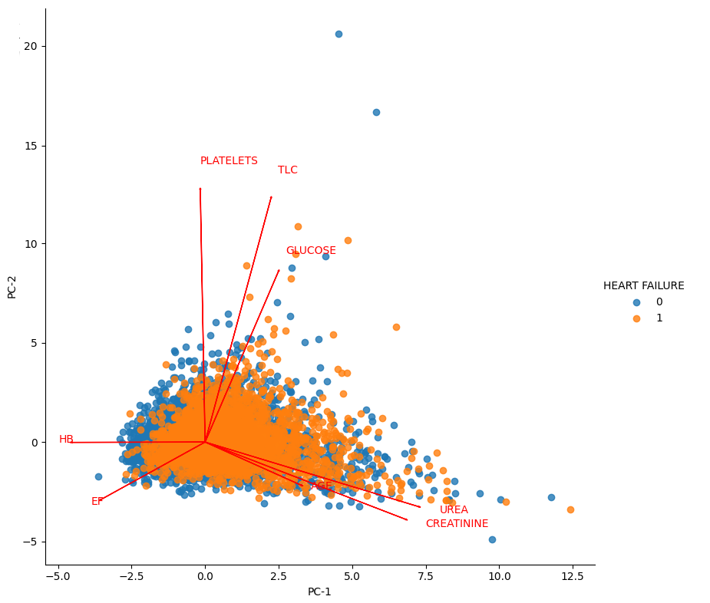
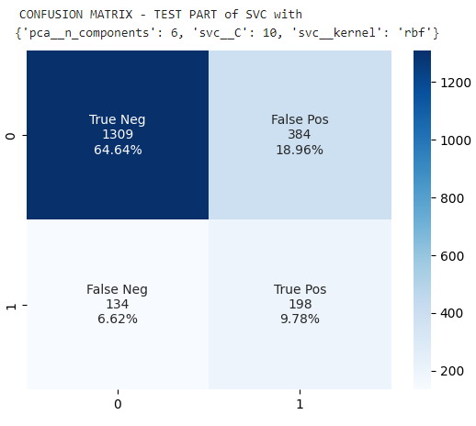
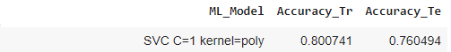
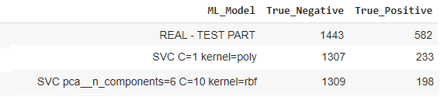
HEART FAILURE – SVC MODEL WITH GRIDSEARCHCV
UREA and EF are not correlated
No dummies
With dummies
With dimension reduction, the overall accuracy reduces a little, but the model predicts significant less True Heart Failure correctly.

Slide 11
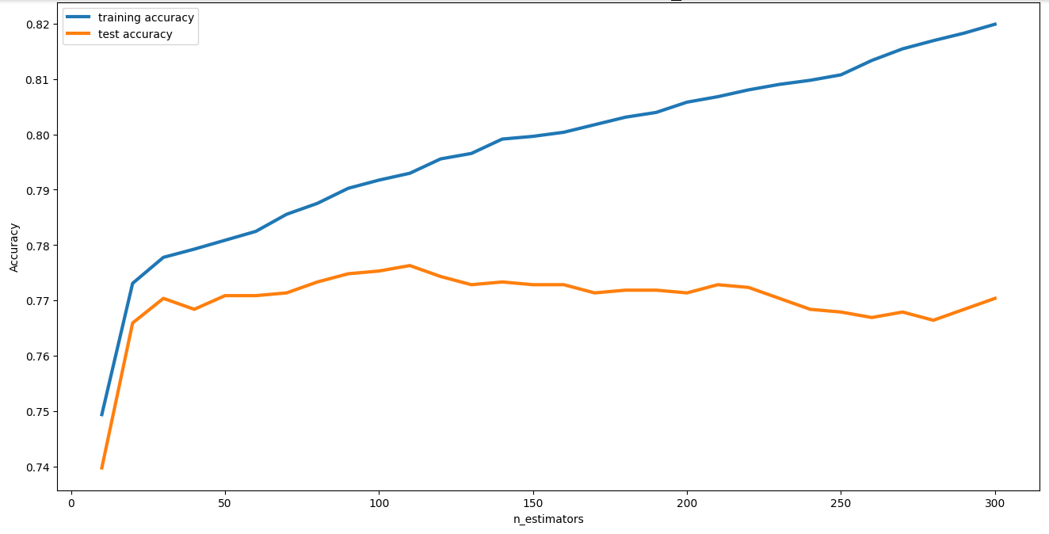
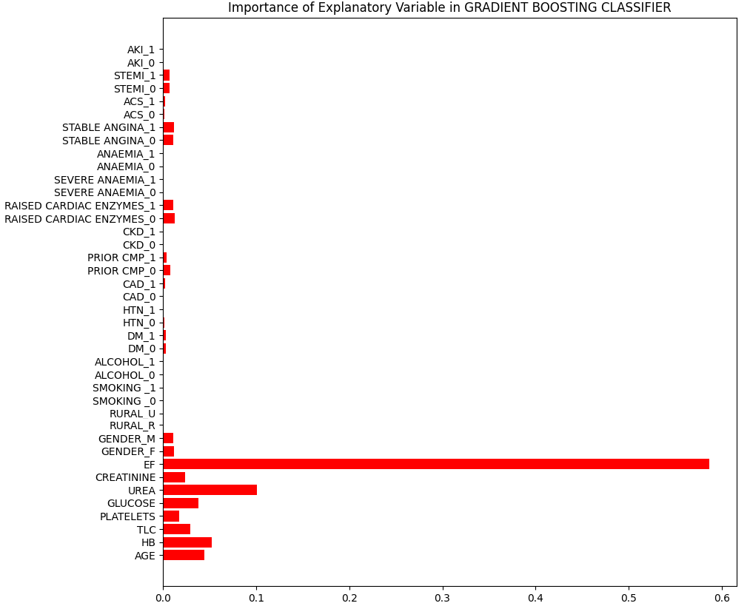
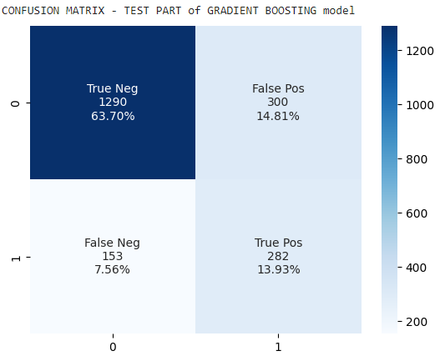
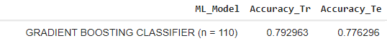
HEART FAILURE – GRADIENT BOOSTING CLASSIFIER
Max. Test accuracy
110
EF is still the most relevant explanatory variable for HEART FAILURE prediction, but other variables have similar relevance of UREA.

Slide 12
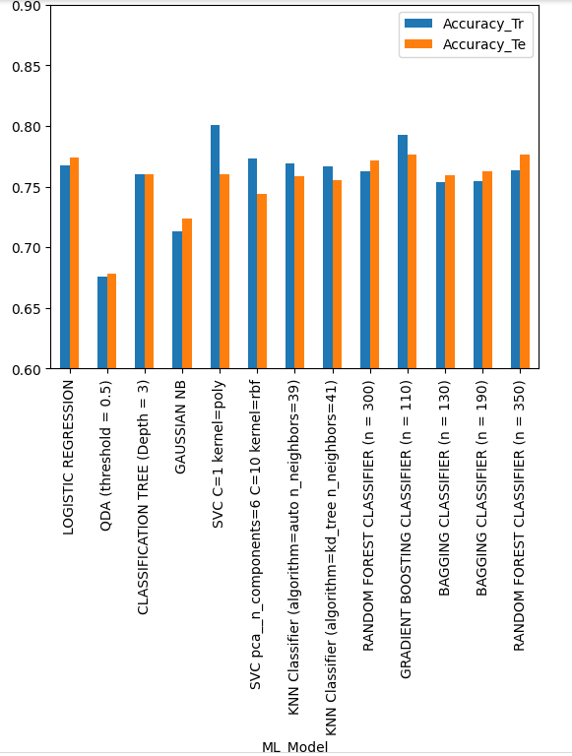
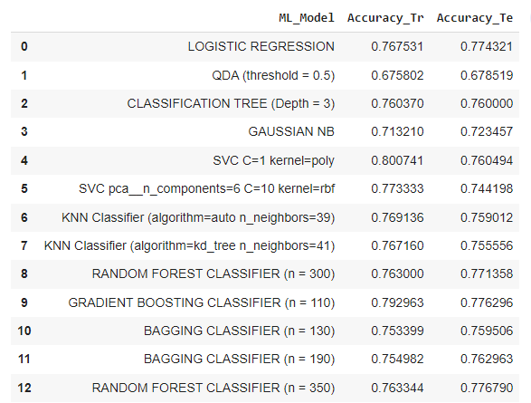
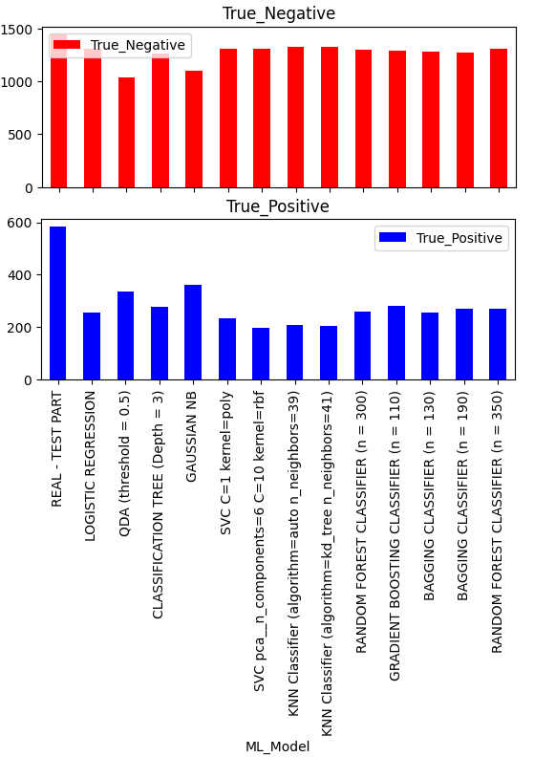
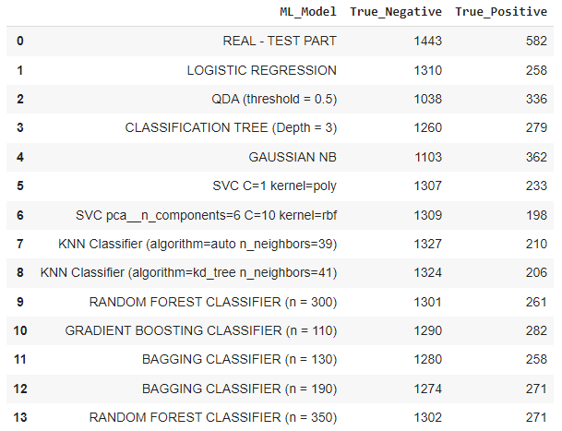
HEART FAILURE – SUMMARY OF ML MODELS
(1)
(1)
(1)
(2)
(3)
(3)
(3)
(3)
(1) GridSearchCV
(2) RandomizedSearchCV
(3) Using Bootstrap (repeated 50 times)

Slide 13
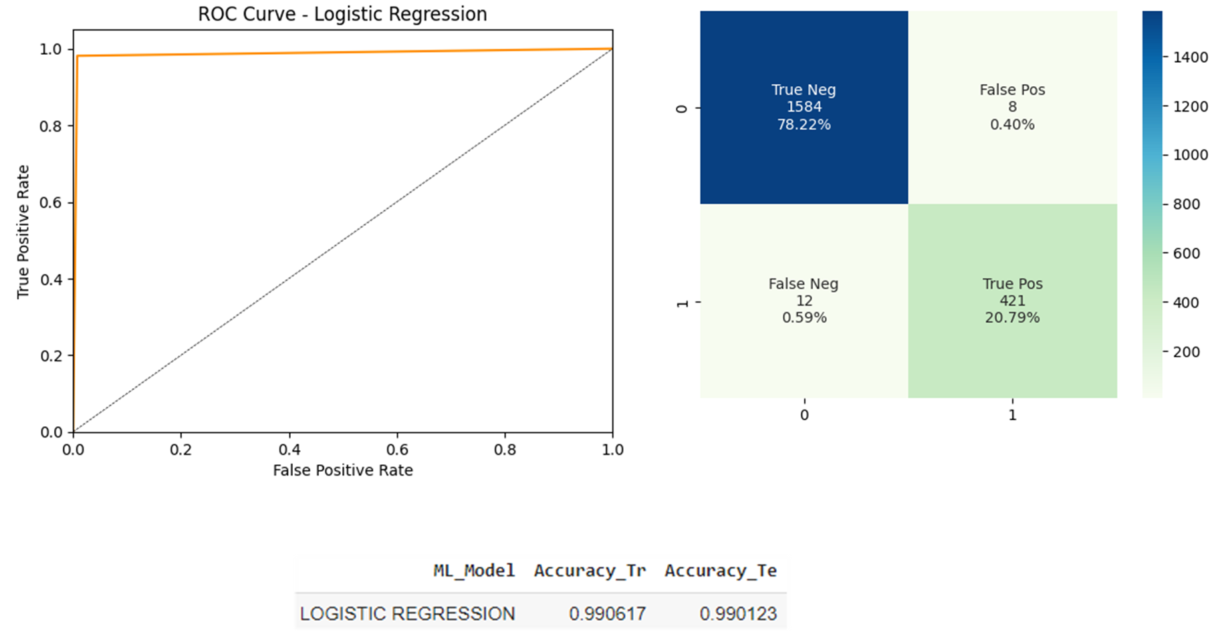
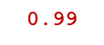
ML MODEL ANALYSIS (AKI) - Logistic regression

Slide 14
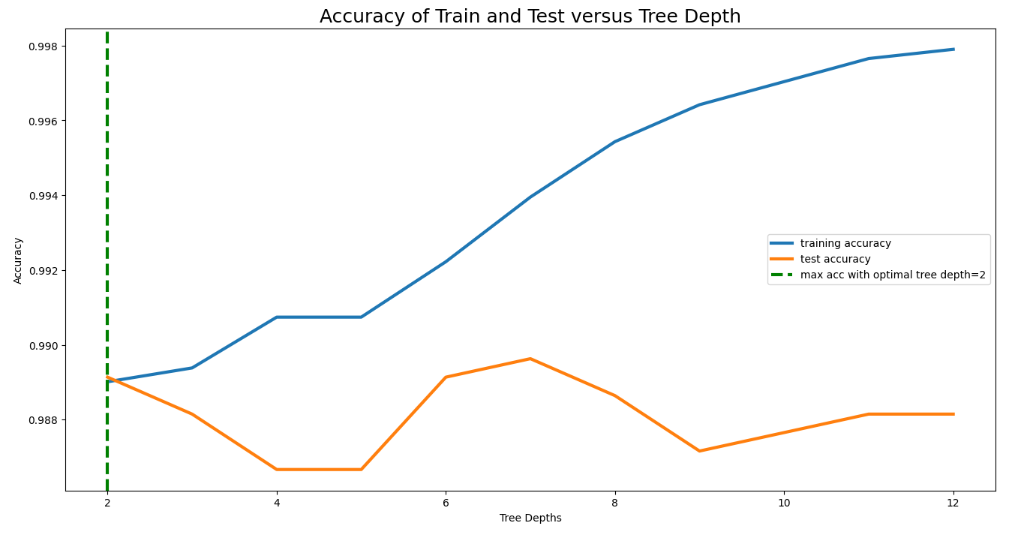
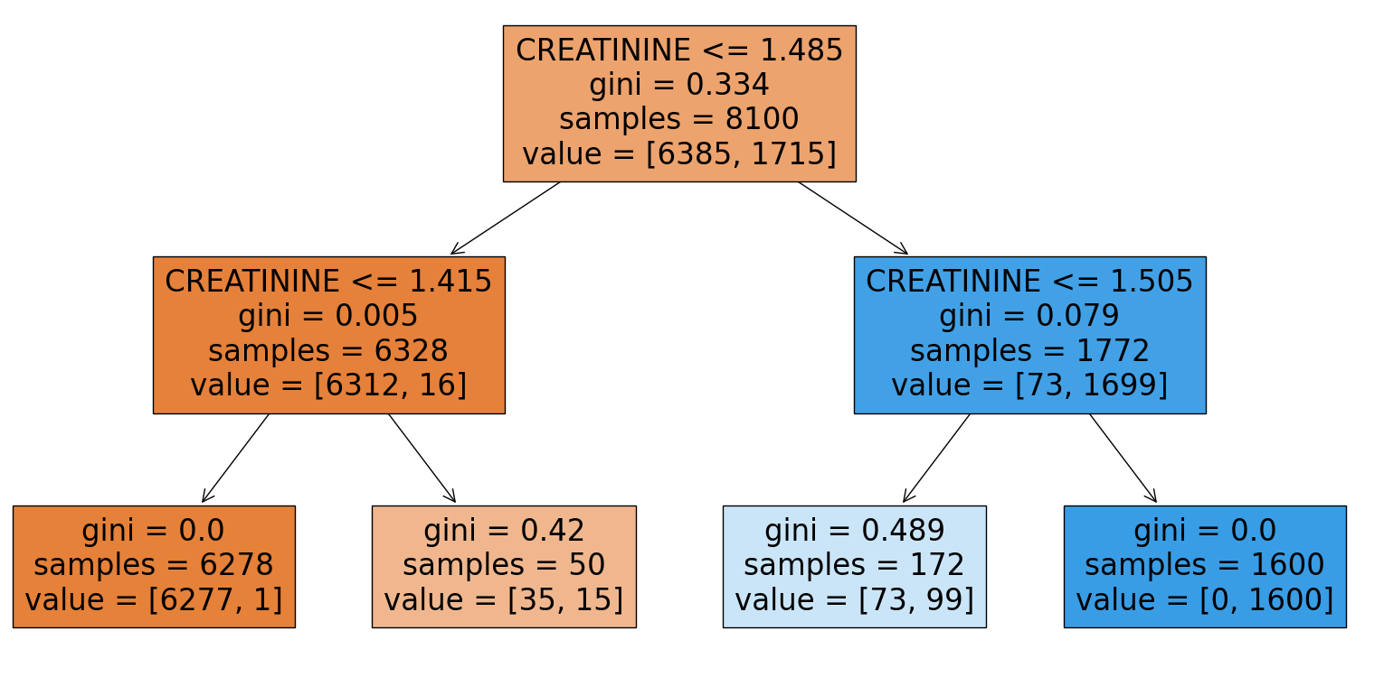
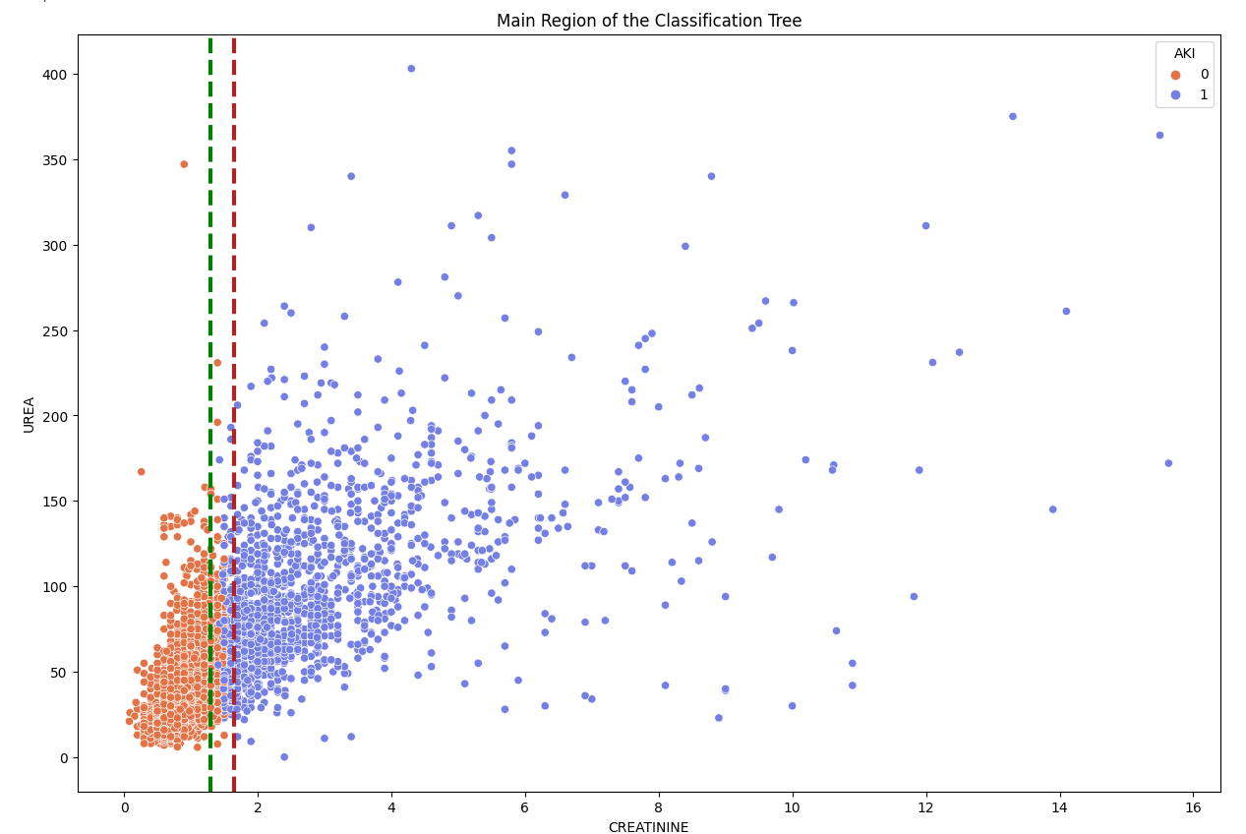
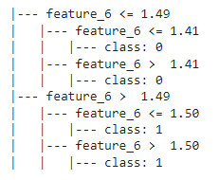
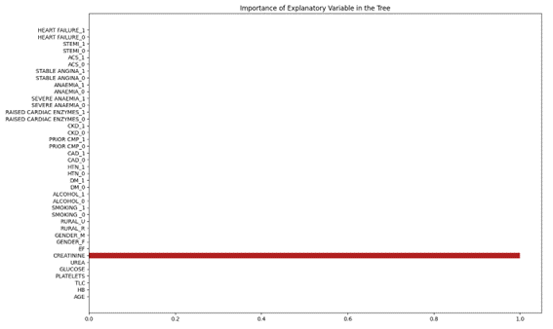
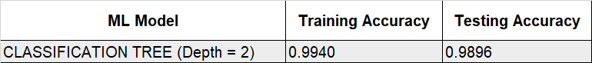
ML MODEL ANALYSIS (AKI) - Classification tree
Optimal Tree depth
2

Slide 15
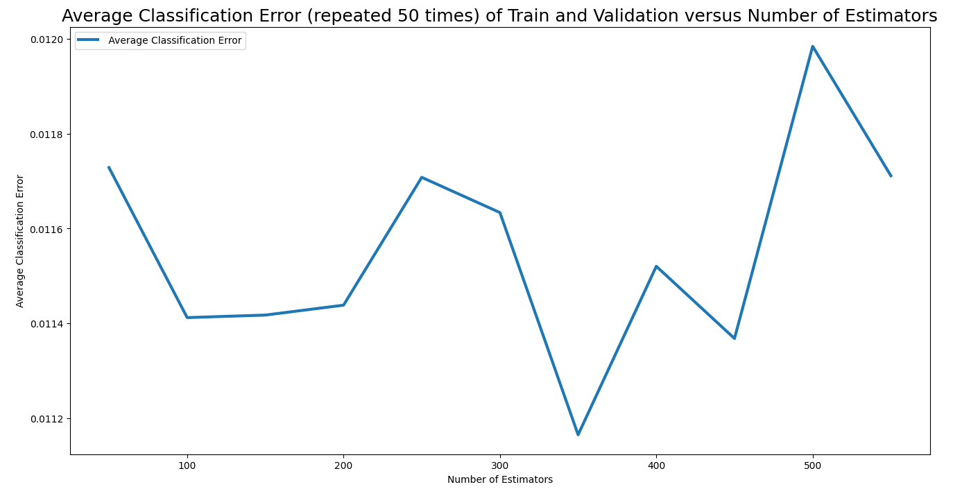
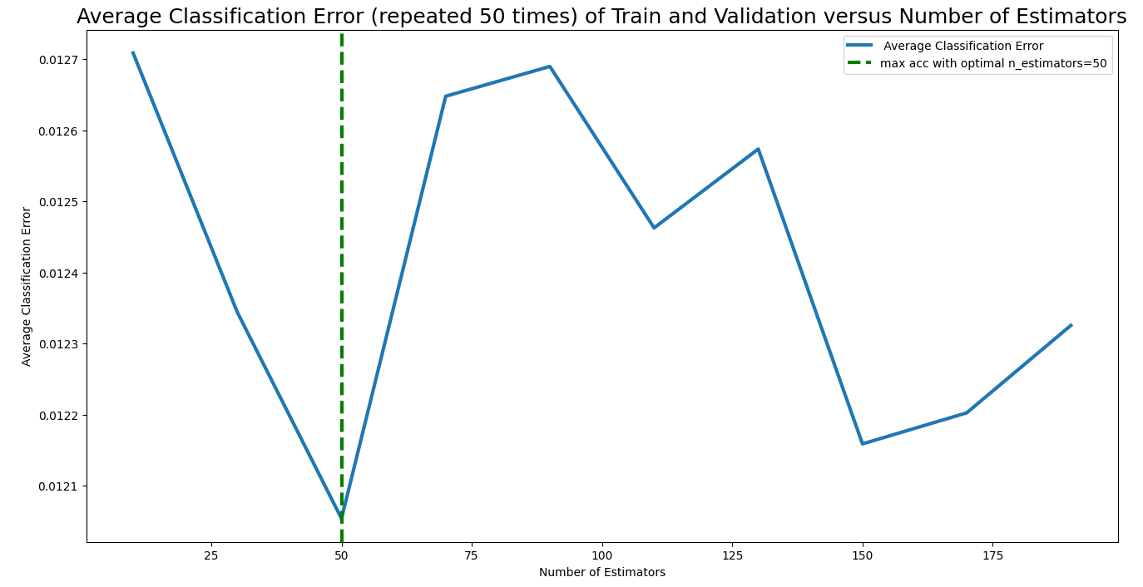
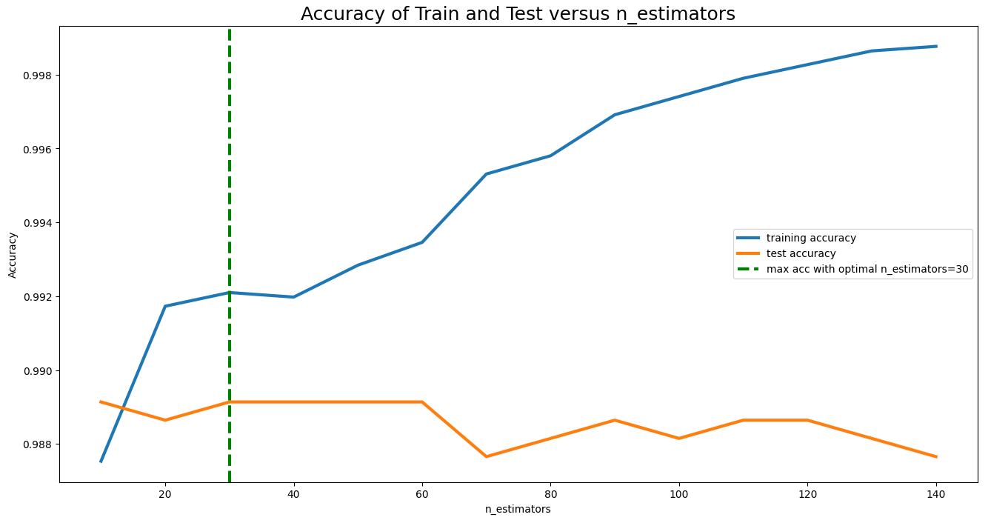
ML MODEL ANALYSIS (AKI) - Bootstrap
Min. Classification Error
Min. Classification Error
350
50
RANDOM FOREST CLASSIFIER
BAGGING CLASSIFIER
Max. Test accuracy
30
GRADIENT BOOSTING CLASSIFIER
Notes:
We have done several ML models among them, 3 are highlighted here.
In random forest, Based on the results of the sensitivity of n_estimators with BOOTSTRAP in the train part, the n_estimators = 250 that indicated the lowest classification error (0.01093), and it was adopted this value to fit the model and found training accuracy is 100% and testing accuracy is 98.96% or 99%
For the model GRADIENT BOOSTING classifier, based on the plot above, the n_estimateor 30 to 60 showing same testing accuracy whereas training accuracy is increasing whcih indicate the higher estimator number will overfit the model. Hence, we took the n_estimators = 30 that indicated the highest accuracy in the test part for GRADIENT BOOSTING CLASSIFIER and this number was used for fitting the model and found training accuracy is 99% and testing accuracy is 98.91% or 99%
For the Bagging classifier model,
Based on the plot above, the n_estimator = 90 that presented the lowest Classification Error and hence It was used to fit the model and found training accuracy is 100% and testing accuracy is 98.7% or 99%
Also we found for these three model cases, the prediction of the true positive or having AKI is same and true negative or no AKI is nearly similar. But random forest gives us highest accurate result.

Slide 16
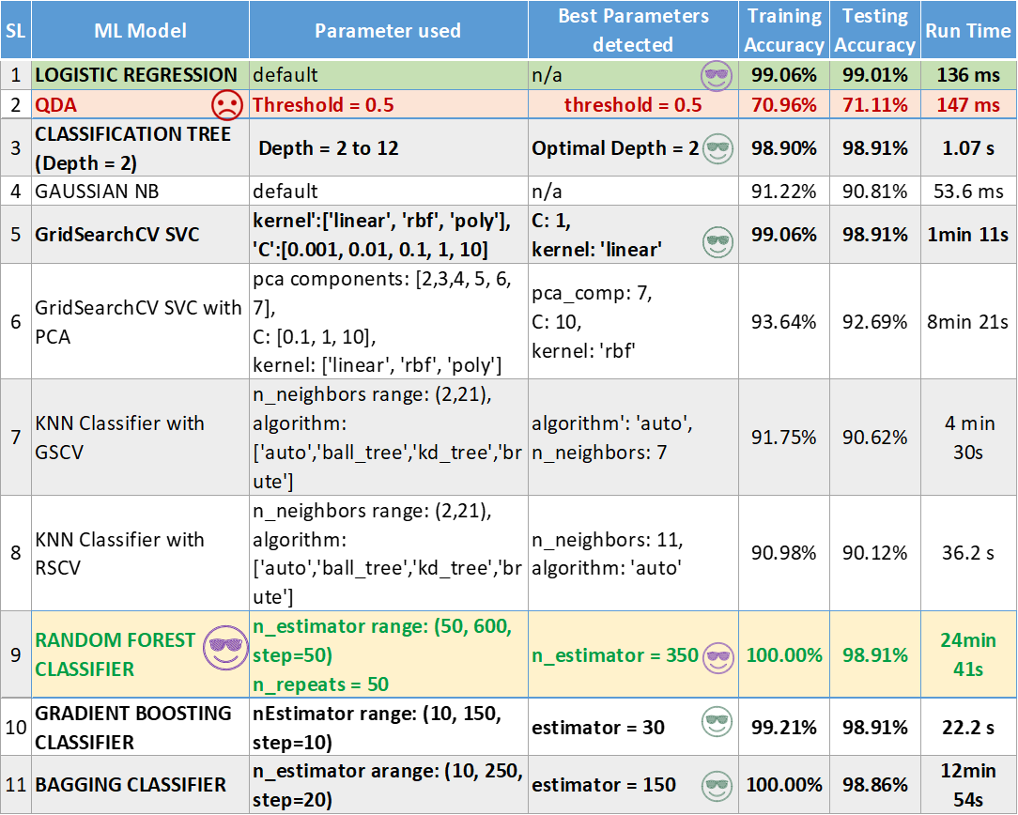
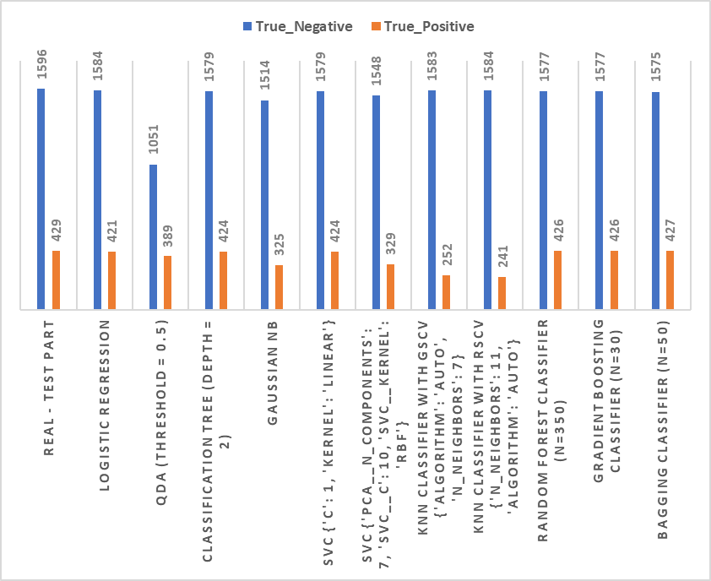
AKI - SUMMARY OF ML MODELS
Best method (Accuracy): Random Forest and others
Best method (Accuracy & Runtime): Logistic Regression
Least method: QDA

Slide 17
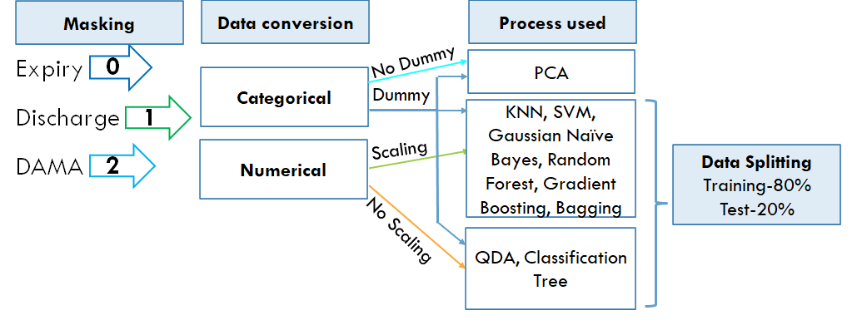
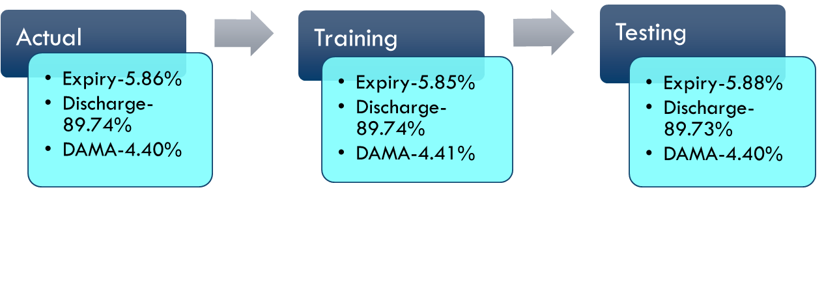
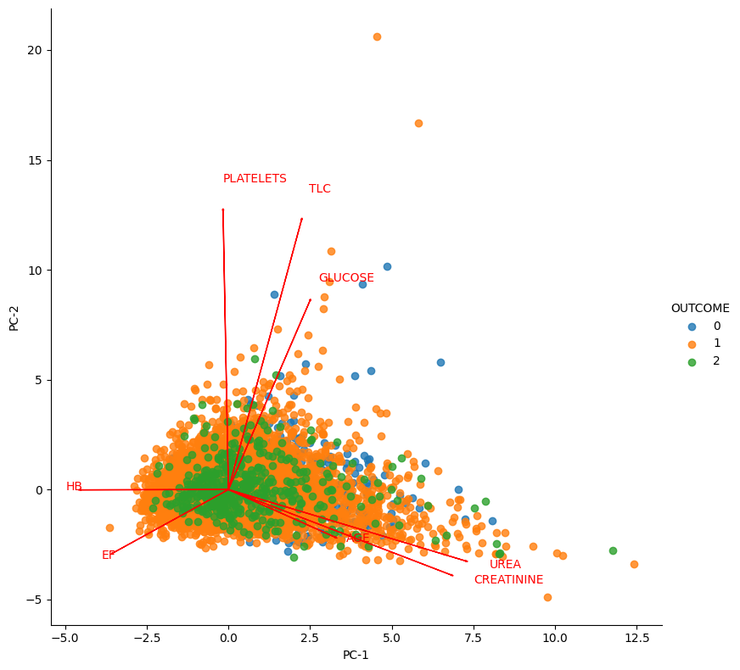
Outcome METHODOLOGY & PCA
Proportions
Methodology
*Expiry=Patient died
*Discharge=Discharge by hospital
*DAMA=Discharge without medical advice
Majority are for Discharge
Random Forest
Gradient Boosting
Classification Tree
PCA
Influential Explanatory Variables
DURATION OF STAY & EF

Slide 18
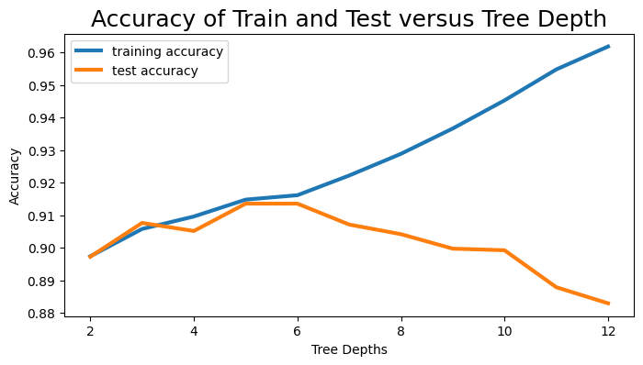
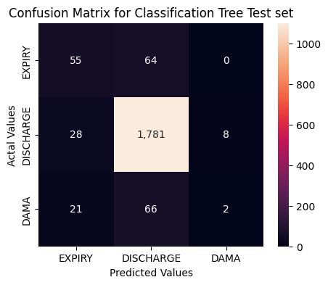
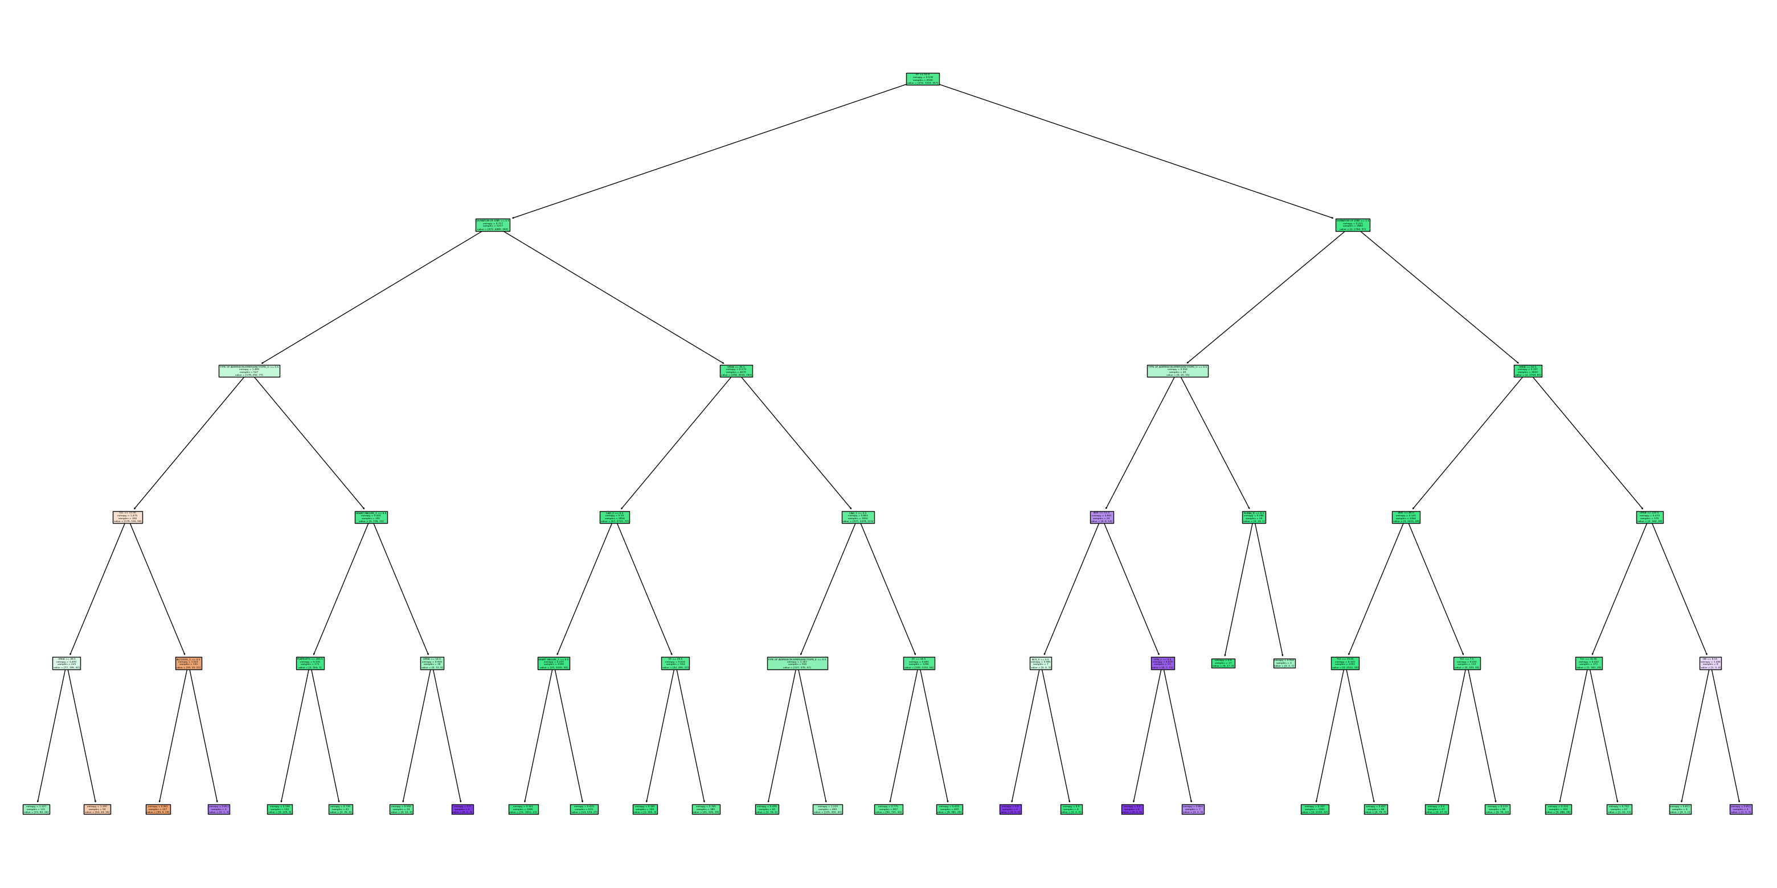
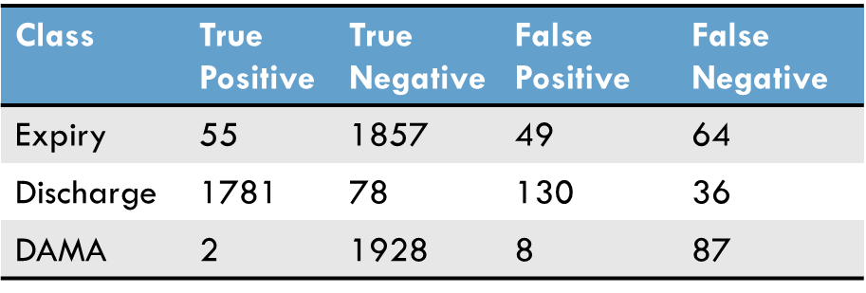
Outcome CLASSIFICATION TREE
5
--DISCHARGE
--EXPIRY
--DAMA

Slide 19
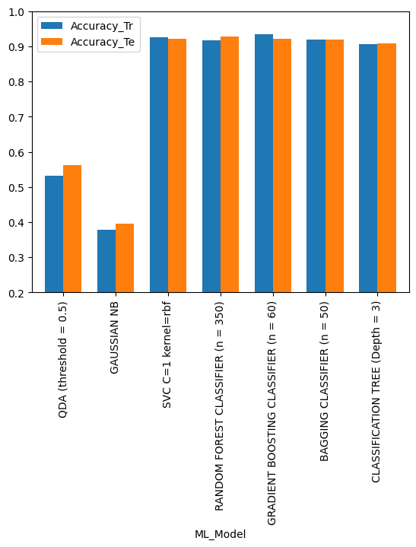
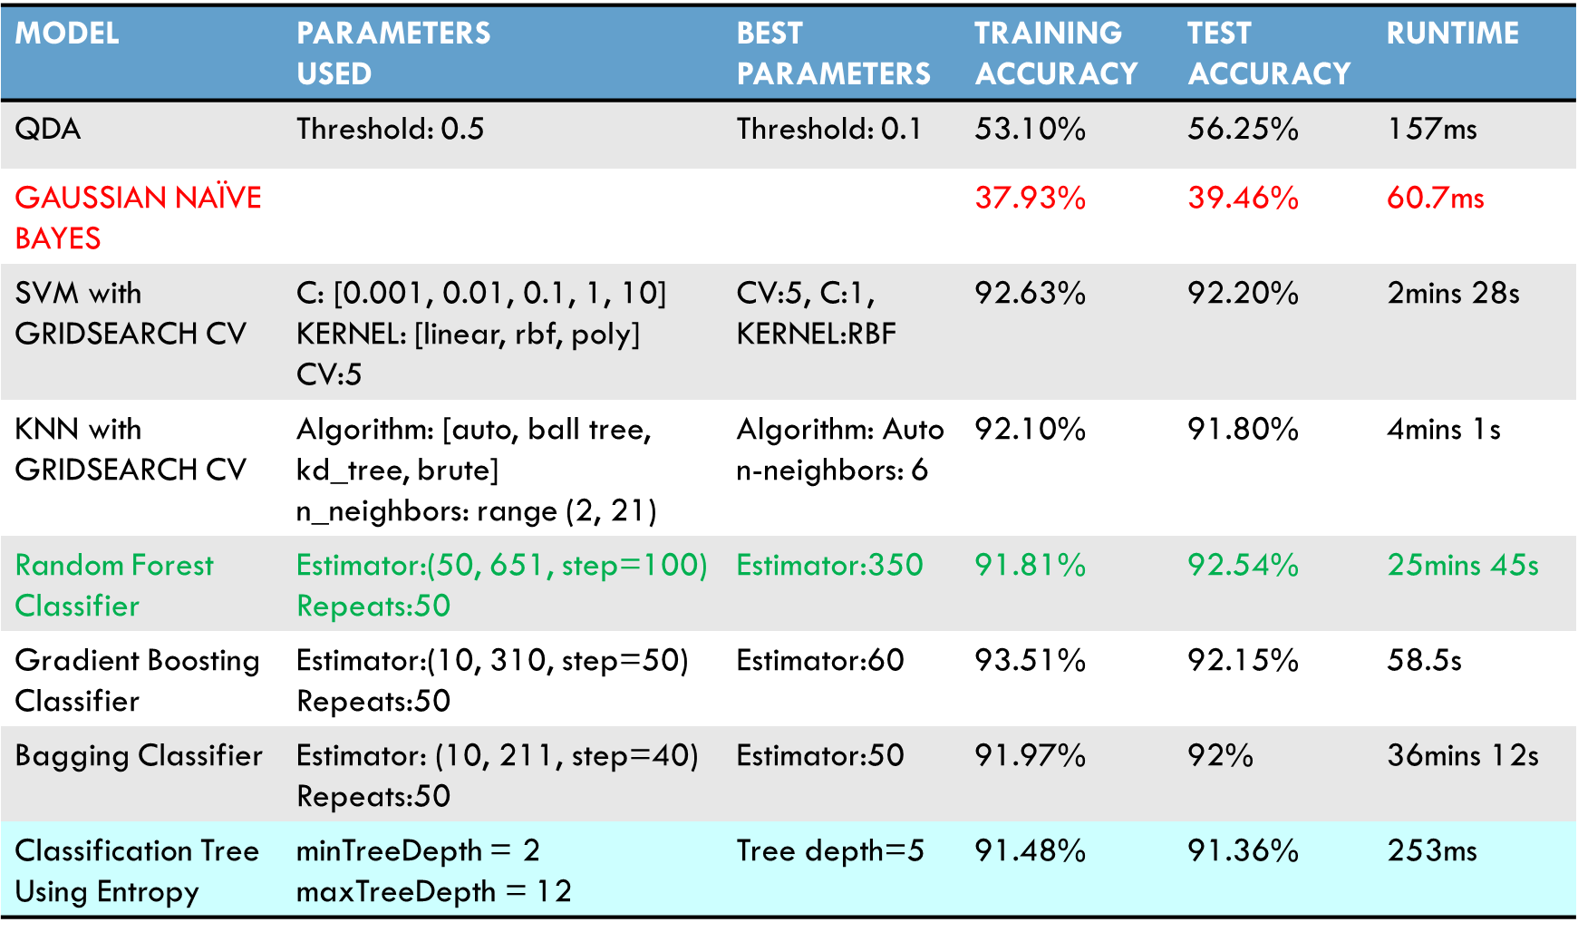


Outcome – SUMMARY OF ML MODELS
Best method considering Accuracy: Random Forest
Best method considering Accuracy & Runtime: Classification Tree

Slide 20
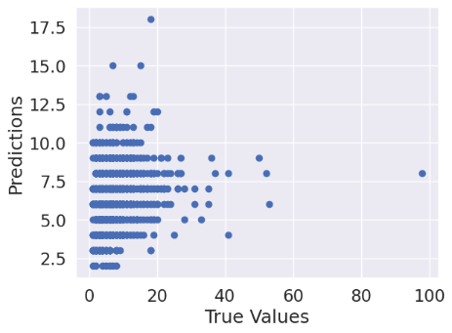
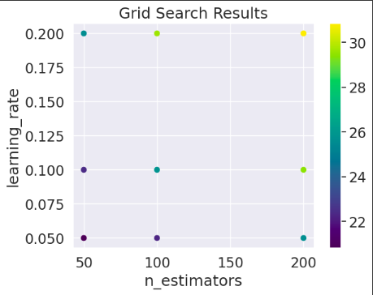
"Duration of Stay" -Boosting techniques
For AdaBoost Regressor True Values vs the Predicted Values on the Test set.
Comparison of hyperparameters with GridSearchCV. The learning rate and n_estimators are identified based on MSE values.
For AdaBoost Regressor the Mean Squared Error is 26.894.​ We tried to get the best hyperparameters for tuning. For AdaBoost Regressor learning_rate = 0.050 and n_estimators = 50 gives the lowest MSE value

Slide 21


"DURATION OF STAY“- BOOSTING TECHNIQUES
For Gradient Boosting Regressor the MSE value is around 26.314. The best hyperparameters are learning_rate : 0.1, loss : huber, max_depth : 4 , n_estimators :50
Features importance from XgBoost Regressor. Here the features are encoded. For XgBoost the value of MSE is 29.239 and RMSE is 5.407
Bagging with Random Forest Regressor gives MSE value of around 26.151 and RMSE of 5.113. The above figure provides the Actual vs Predicted
Gradient Boosting Regressor gives the lowest MSE of 26.314.

Slide 22



"DURATION OF STAY“- KNN Regression
Using only quantitative variables
Before Scaling
KNN Regression
Scaled independent variables

Slide 23




SUMMARY OF "DURATION OF STAY"

Slide 24

CONCLUSION
The main variables that influences a patient diagnosticated with HEART FAILURE are Ejection Fraction (EF) and UREA.
Gradient Boosting Classifier (n = 110), Random Forest Classifier (n = 350) and Logistic Regression were the best ML models to predict HEART FAILURE in test part (test accuracy > 77%).
Creatinine is the main explanatory variable for AKI.
Random Forest and Logistic regression are the best models for AKI.
Explanatory variables that influence OUTCOME are Duration of Stay & EF.
Gaussian Naïve Bayes has the worst accuracy and Random Forest Classifier(n=350) has the best accuracy for response variable OUTCOME.
For "DURATION OF STAY", the explanatory variables could not achieve a high degree of accuracy
Age is the main explanatory variable for “DURATION OF STAY"
Of all methods employed in Machine Learning for "DURATION OF STAY", the KNN Regressor with k folds splitting produced the least MSE value.

Slide 25

ANY QUESTIONS?

Slide 26
REFERENCES
1.Hospital Admissions Data, Kaggle. Available at https://www.kaggle.com/datasets/ashishsahani/hospital-admissions-data/discussion/302894?resource=download&select=HDHI+Admission+data.csv (accessed on Jan. 25,2023).
2.Bollepalli, S.C.; Sahani, A.K.; Aslam, N.; Mohan, B.; Kulkarni, K.; Goyal, A.; Singh, B.; Singh, G.; Mittal, A.; Tandon, R.; Chhabra, S.T.; Wander, G.S.; Armoundas, A.A. An Optimized Machine Learning Model Accurately Predicts In-Hospital Outcomes at Admission to a Cardiac Unit. December 12,2022, Kaggle. Available at https://doi.org/10.3390/diagnostics12020241 (accessed on Jan. 30,2023).
3.Attribution-NonCommercial-ShareAlike 4.0 International (CC BY-NC-SA 4.0),Creative Commons, Available at https://creativecommons.org/licenses/by-nc-sa/4.0/ (accessed on Jan. 30,2023).
4.Leading causes of death, February 22,2022, Open Canada-Government of Alberta. Available at https://open.canada.ca/data/en/dataset/03339dc5-fb51-4552-97c7-853688fc428d (accessed on Jan. 28,2023).

